Slide 1



Digital Citizenship
Jubail International School
Presented by:Waqqad

Slide 2
Leaders of Excellence in International Education
What is it?

Slide 3
This is our
VISION

Slide 4
What is it?
To provide outstanding Education based on International Standards.

Slide 5
MISSION
This is our

Slide 6
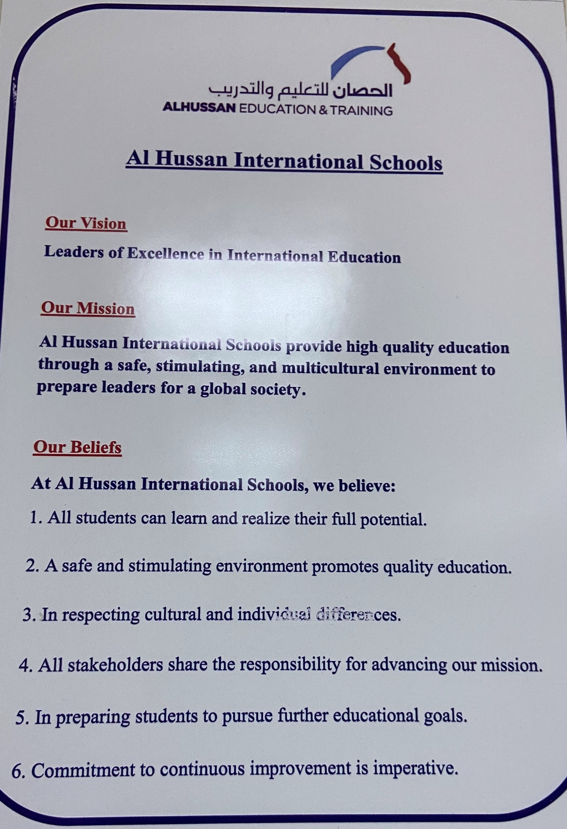

Slide 7
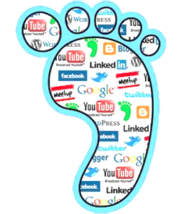
Digital Citizenship:
The norms of appropriate, responsible behavior with regard to technology use.
What is ..

Slide 8
Learning Objectives
Understand what is meant by digital Citizenship
Identify the ways to avoid digital distractions
Use the digital habits to become a responsible Digital Citizen

Slide 9


What do you know about Digital Citizenship
ⓘ Start presenting to display the poll results on this slide.

Slide 10

Digital Citizenship
ⓘ Start presenting to display the poll results on this slide.

Slide 11

What Is Digital Citizenship

Slide 12
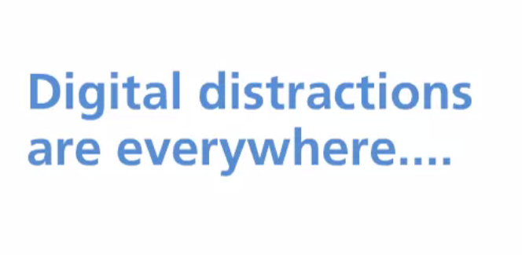

Slide 13


Slide 14


Slide 15
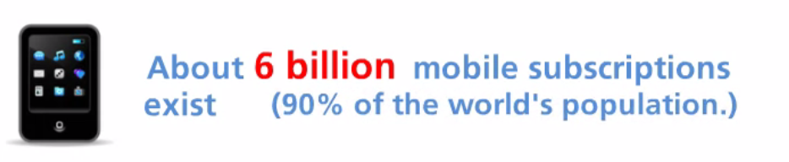

Slide 16
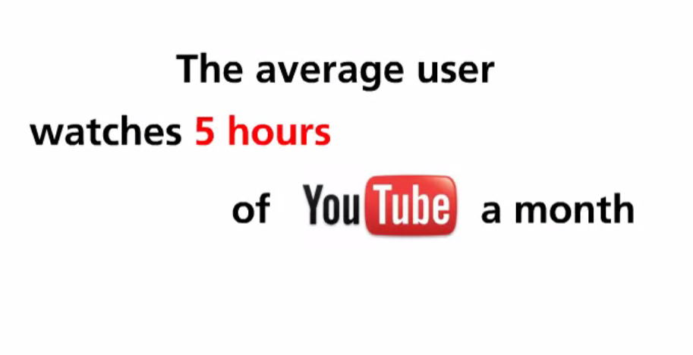

Slide 17
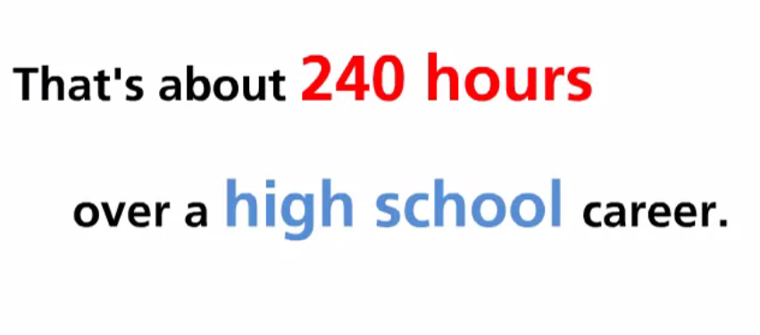

Slide 18
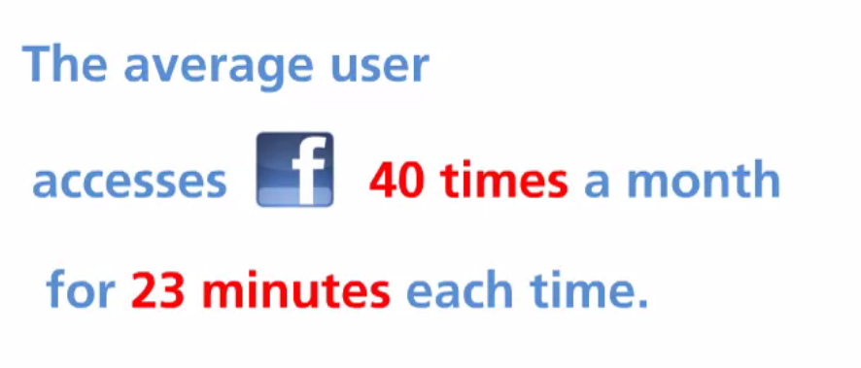

Slide 19
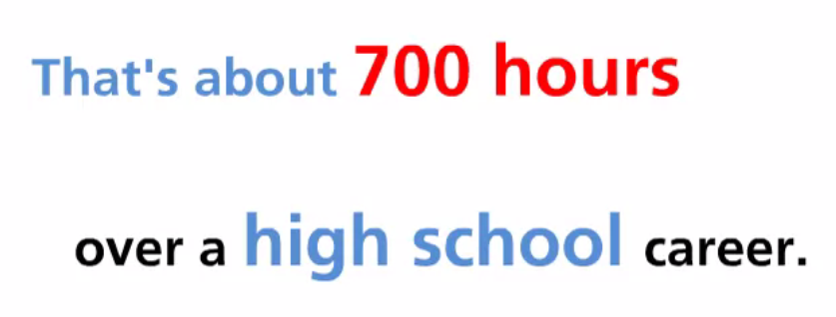

Slide 20
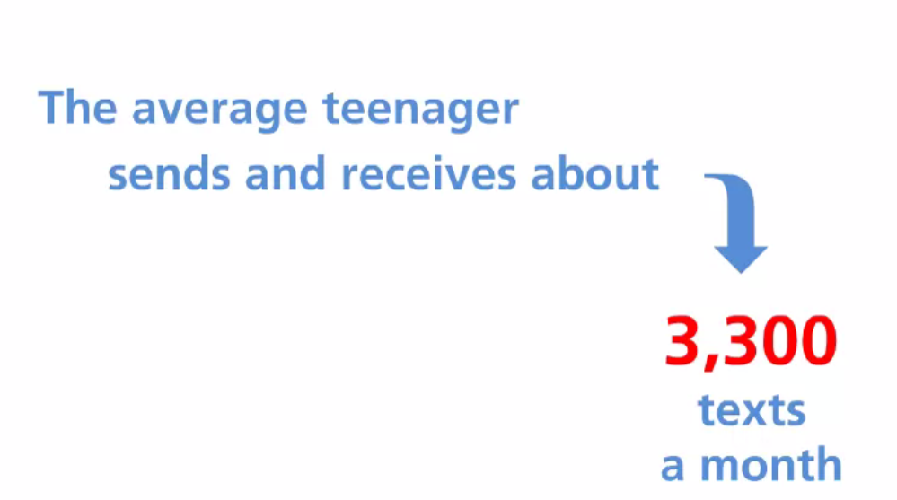

Slide 21
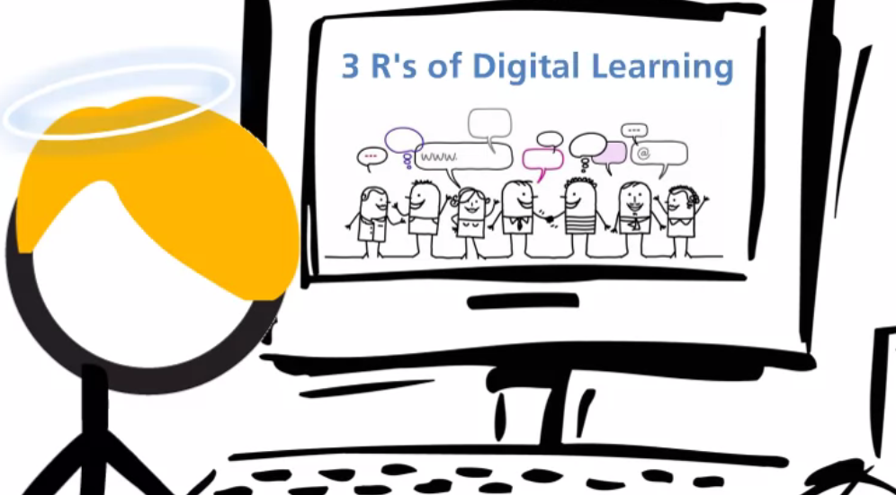

Slide 22
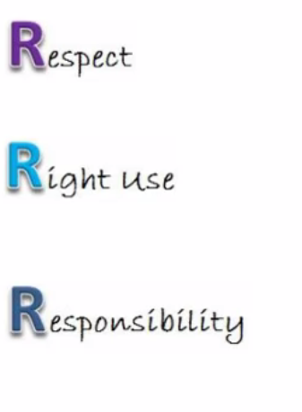

Slide 23


Slide 24
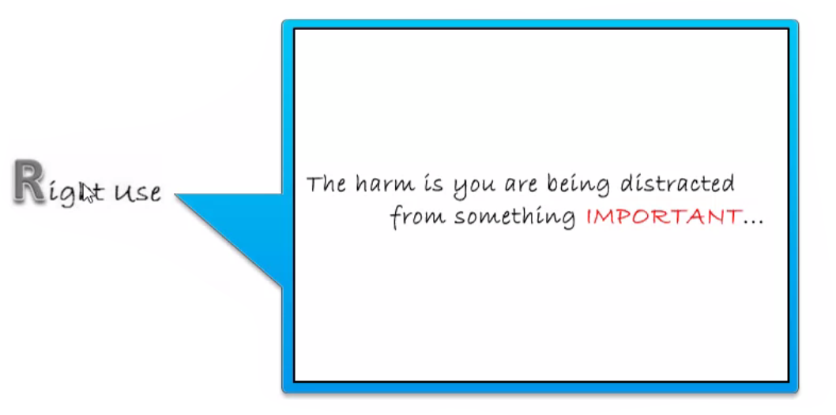

Slide 25


Slide 26
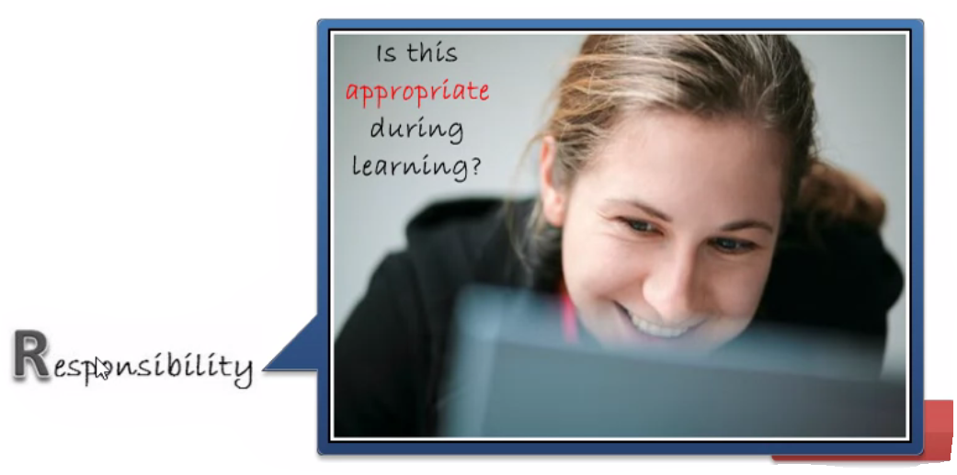

Slide 27
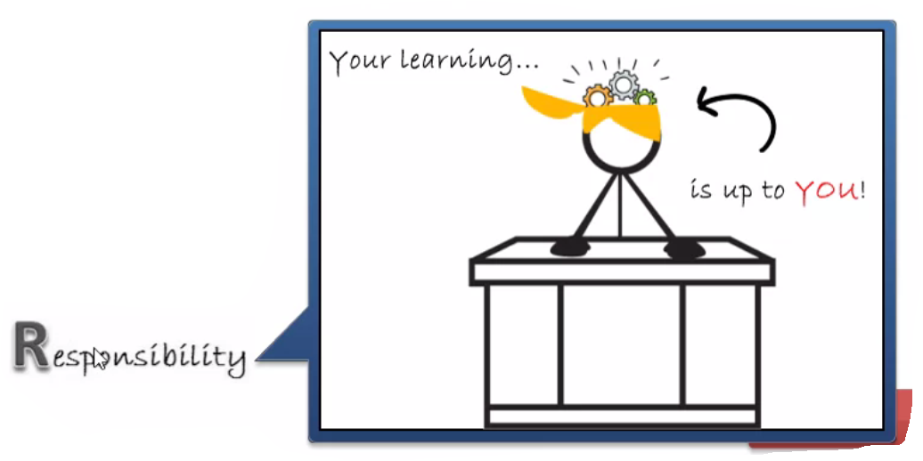

Slide 28

Being a Good Digital Citizen

Slide 29


Slide 30
What it takes to be a good Digital Citizen
ⓘ Start presenting to display the poll results on this slide.

Slide 31
What are three R’s of the Digital Learning?
What is meant by respect in Digital Learning?
What is meant by right use in Digital Learning?
What is meant by responsibility in Digital Learning?

Slide 32
Questions
https://teacher.aeseducation.com/courses/173844/dashboard/preview

Slide 33
